Slide 1
UX/UI CASE STUDY
Aruna Andrew

Slide 2
EXECUTIVE SUMMARY
For this particular project, my task was to create a website that would highlight my skills and experience. I began the process by utilizing Figma to craft a design that accurately represented myself and my professional pursuits. Within the design, I included a navigation bar that featured an About Me section, my Resume, a Contact Me form, and social media links- specifically, my LinkedIn profile to connect with my portfolio. With the design complete, it was time to move on to coding the website while maintaining the integrity of the original design.
Google Drive

Slide 3
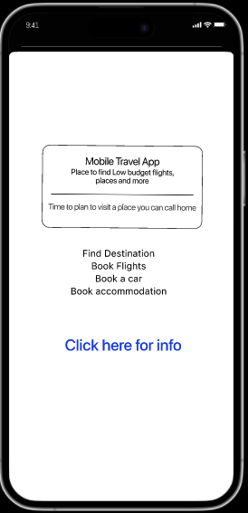
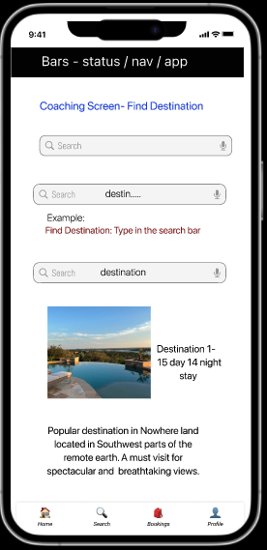
Mobile Travel App
PROJECT SUMMARY
Creating a user-friendly travel app with multiple features can prevent users from losing out on opportunities.
MY RESPONSIBILITIES
My core responsibilities were to
Interview the users
Analyze and develop solutions to the problems
Sketch, wireframe & Prototype
Link

Slide 4
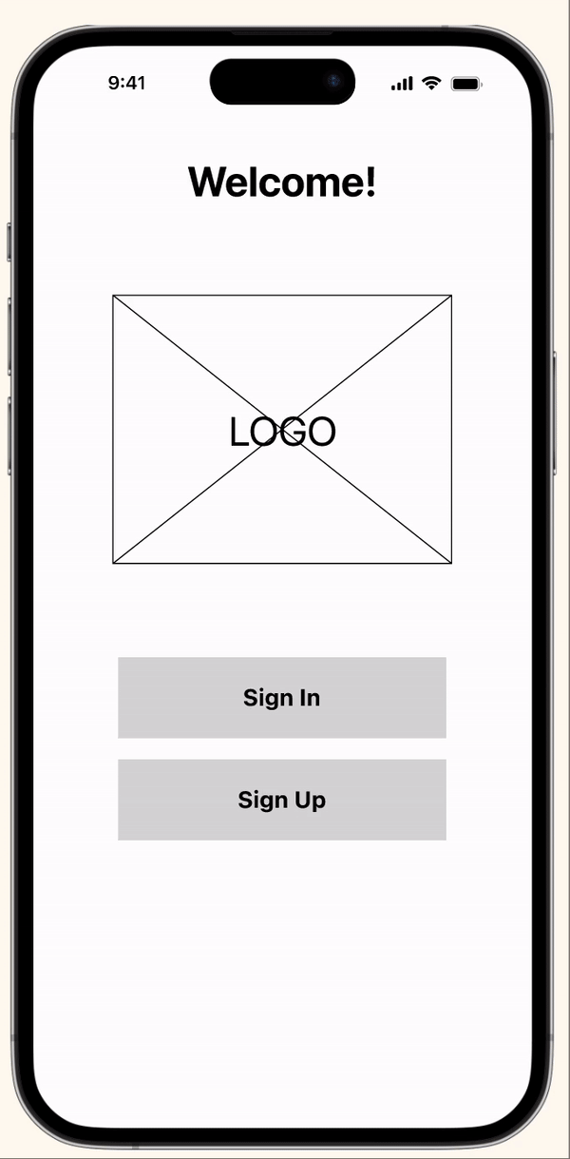
Mobile App- Room Finder
Insert mockup here
MOBILE PROTOTYPE
Designing an app that offers a range of features in a single, user-friendly platform so that users will stay on track with their previous search methods resulting in lost opportunities.
GOAL
Goal was to create community app that allows young professionals and college students to find roommates that they feel will be a compatible match.
MY ROLE & RESPONSIBILITIES
My core responsibilities were to
Research
Prototype
Test
Validate
TIMELINE
Four-weeks
Google Drive

Slide 5
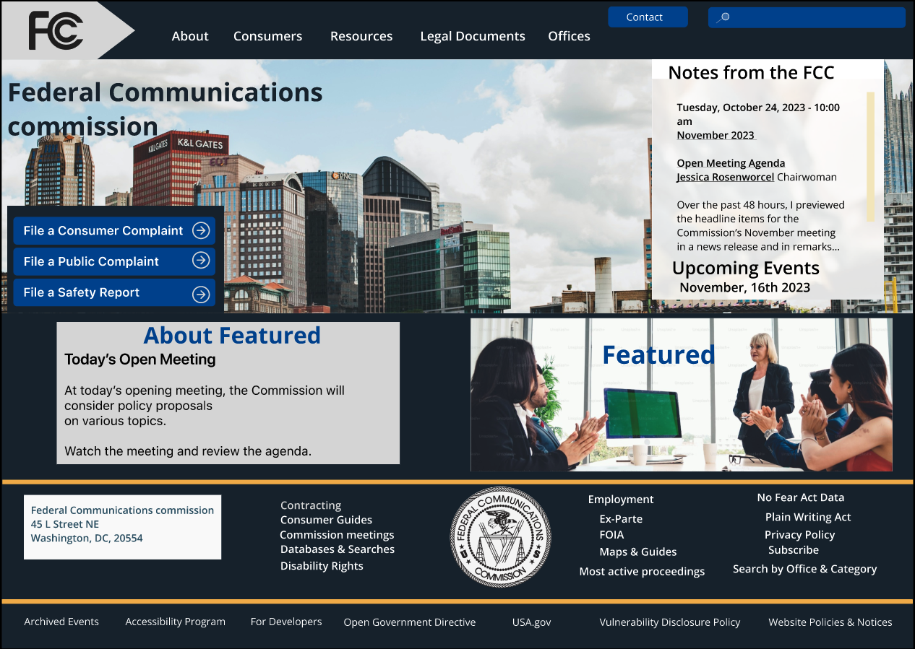
Responsive Website Design
Project Overview
THE PROBLEM:
The user is attempting to file a complaint on the FCC’s website due to extended wait times on the listed phone number.
GOAL
Redesign the website to make it user-friendly and easy to navigate, allowing users to quickly find necessary information.
MY ROLE & RESPONSIBILITIES
My core responsibilities were to
Research, Interview
Find the solution, Analyze the Original Website
Redesign, Sketch, Prototype and Test.
TIMELINE
Three-Weeks
Google Drive

Slide 6
PROJECT DETAIL PAGES
Details of the Non-profit Organization RWD-
Case Study

Slide 7
What to Show in Project Detail Pages
Google Drive
Include the Design Process & What You Did: We chose to redesign a Non-profit organization’s website for this project.
  The Problem: Liberation Cat House’s website and social media were inconsistent, causing it to blend in with other rescue groups.
  The Solution: Designing a website that enables potential adopters to experience improved sustainability that aligns with our digital image ultimately leading to an increase in feline adoptions.
Discuss Your User Research : We sent a survey and interviewed potential adopters to understand their pain points and frustrations.
Describe Your Definition / Ideation / Sketching / Prototyping Phases (refer to the case study outline instructions)
Show Your User Testing + Outcomes (refer to the case study outline instructions)
Describe Your Lessons Learned
What happened in the end? Don’t forget to be reflective and include considerations such as what you learned as a designer.
Discuss Future Opportunities
In hindsight, what would you do differently next time? If you had more time, what would you improve?

Slide 8
PROJECT NAME
GOES HERE
In this research project, we planned and conducted five interviews with users one stakeholder interview and potential users in Texas and Florida.
01.WHAT I DID
02. THE PROCESS
03. USER RESEARCH & FINDINGS
04. IDEATION DESIGN
05. USABILITY TESTING & FINDINGS
06. INTERACTIVE PROTOTYPE
07. COMPLETE CASE STUDY
6
1-1 Interviews
5
Users in Group Sessions
1
Client Stakeholder Interviews
Overview of the project

Slide 9
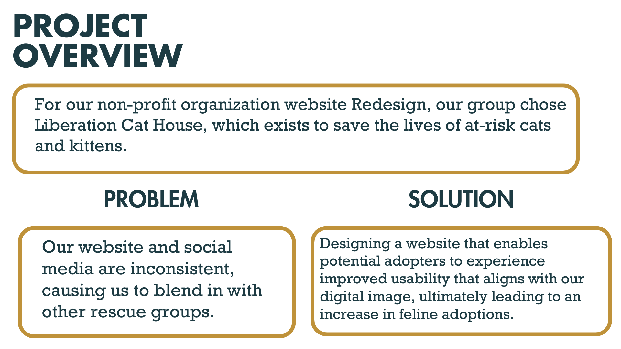
Non-profit organization
Website Redesign
01.WHAT I DID
02. THE PROCESS
03. USER RESEARCH & FINDINGS
04. IDEATION DESIGN
05. USABILITY TESTING & FINDINGS
06. INTERACTIVE PROTOTYPE
07. COMPLETE CASE STUDY
The above slide gives the overview, problem and the solution.

Slide 10
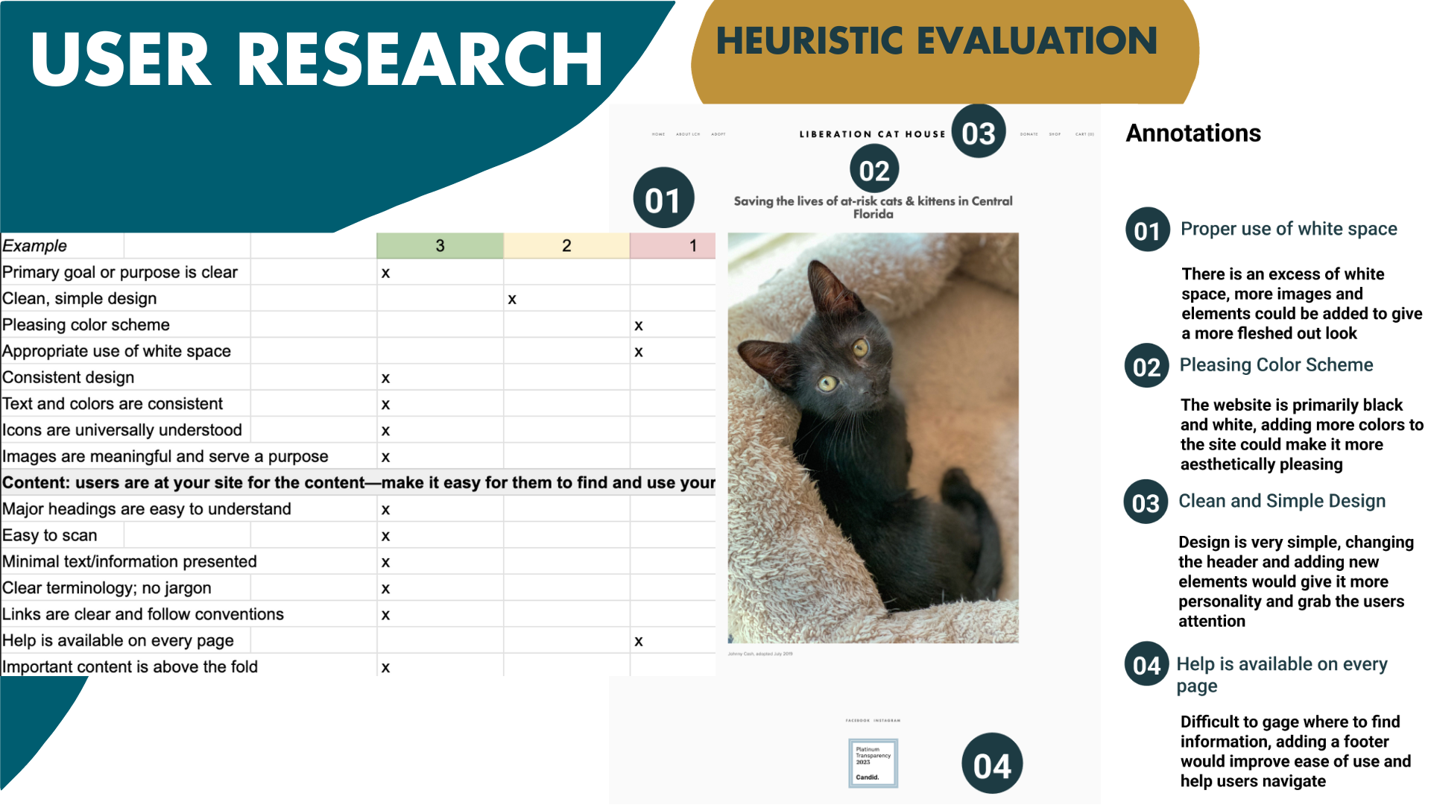
PROJECT NAME
GOES HERE
01.WHAT I DID
02. THE PROCESS
03. USER RESEARCH & FINDINGS
04. IDEATION DESIGN
05. USABILITY TESTING & FINDINGS
06. INTERACTIVE PROTOTYPE
07. COMPLETE CASE STUDY
Heuristic Evaluation of the Original Website

Slide 11
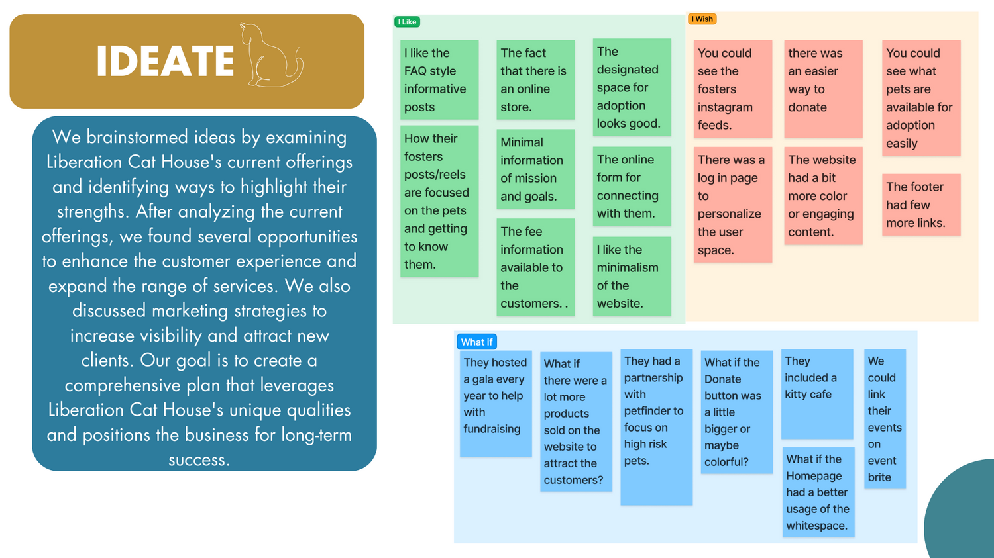
PROJECT NAME
GOES HERE
01.WHAT I DID
02. THE PROCESS
03. USER RESEARCH & FINDINGS
04. IDEATION DESIGN
05. USABILITY TESTING & FINDINGS
06. INTERACTIVE PROTOTYPE
07. COMPLETE CASE STUDY
This is your caption for the above image. Explain why it is included in a 2-3 sentences.

Slide 12
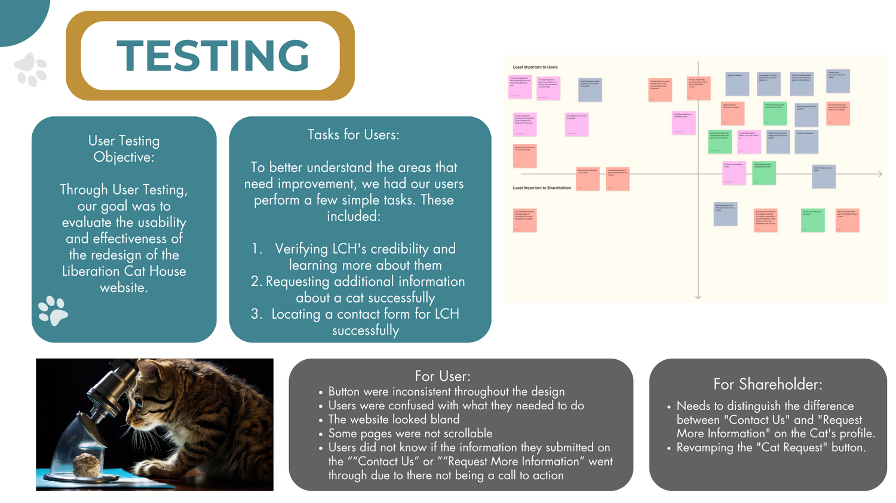
PROJECT NAME
GOES HERE
This is a placeholder for a deliverable.
01.WHAT I DID
02. THE PROCESS
03. USER RESEARCH & FINDINGS
04. IDEATION DESIGN
05. USABILITY TESTING & FINDINGS
06. INTERACTIVE PROTOTYPE
07. COMPLETE CASE STUDY
This is your caption for the above image. Explain why it is included in a 2-3 sentences.

Slide 13
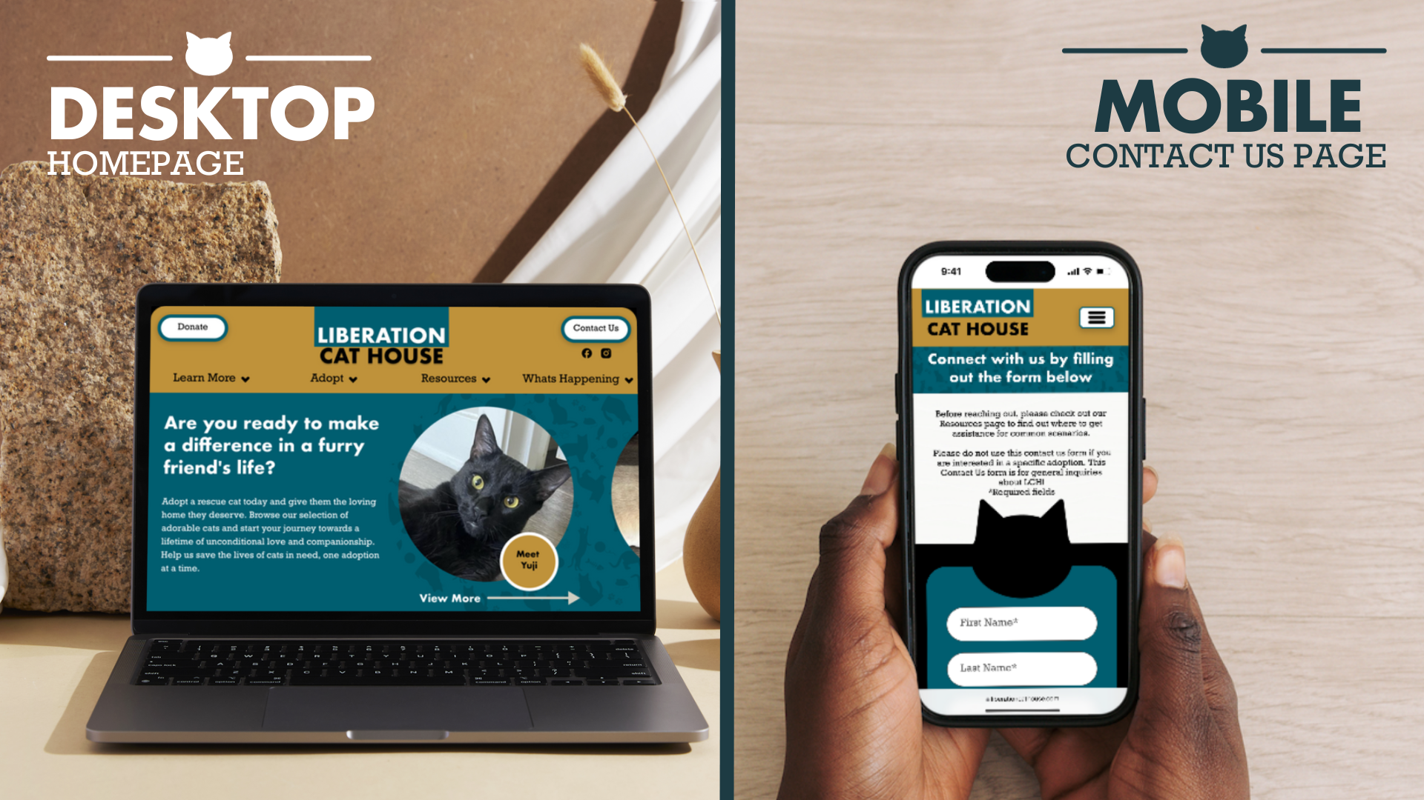
PROJECT NAME
GOES HERE
01.WHAT I DID
02. THE PROCESS
03. USER RESEARCH & FINDINGS
04. IDEATION DESIGN
05. USABILITY TESTING & FINDINGS
06. INTERACTIVE PROTOTYPE
07. COMPLETE CASE STUDY
Final design of the Desktop and the Mobile versions.

Slide 14
PROJECT NAME
GOES HERE
01.WHAT I DID
02. THE PROCESS
03. USER RESEARCH & FINDINGS
04. IDEATION DESIGN
05. USABILITY TESTING & FINDINGS
06. INTERACTIVE PROTOTYPE
07. COMPLETE CASE STUDY
I wrote a case study about this project to show the design process and share more about some of the challenges we overcame.
READ THE CASE STUDY

